Slide 1







SORPTION AND INCORPORATION OF CAESIUM TO SEDIMENTS AND
ILLITE CLAY: A MACRO TO MOLECULAR SCALE INVESTIGATION
Fuller A. J.^{1,2}, Shaw S.^{1,2}, Ward M. B.¹, Haigh S. J.², Mosselmans F. W.³, Peacock C. L.¹, Stackhouse S.¹, Dent A. J.³, Trivedi D.⁴, Small J. S.,⁴ Abrahamsen L. G.⁴
and Burke I. T.
¹University of Leeds
²University of Manchester
³Diamond Light Source Ltd.
⁴National Nuclear Laboratory Ltd.
Frontiers in Environmental Radioactivity, London, January 2016

Slide 2
Radiocaesium (¹³⁷Cs) as a contaminant
High yield fission product (6.3 %)
β,γ decay to ¹³⁷Ba; t½ = 30.2 years
Very soluble in water as Cs⁺
Readily taken up by biota
Interacts strongly with soil minerals; esp. clays

Slide 3
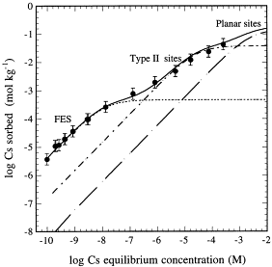
Cs Sorption behaviour
Cs sorption to Na Illite (@7 days)
At different Cs concentrations Cs is taken up to different sorption sites
Poinssot et al., GCA, 1999; Bradbury and Baeyens, J. Contam. Hydrol., 2000

Slide 4
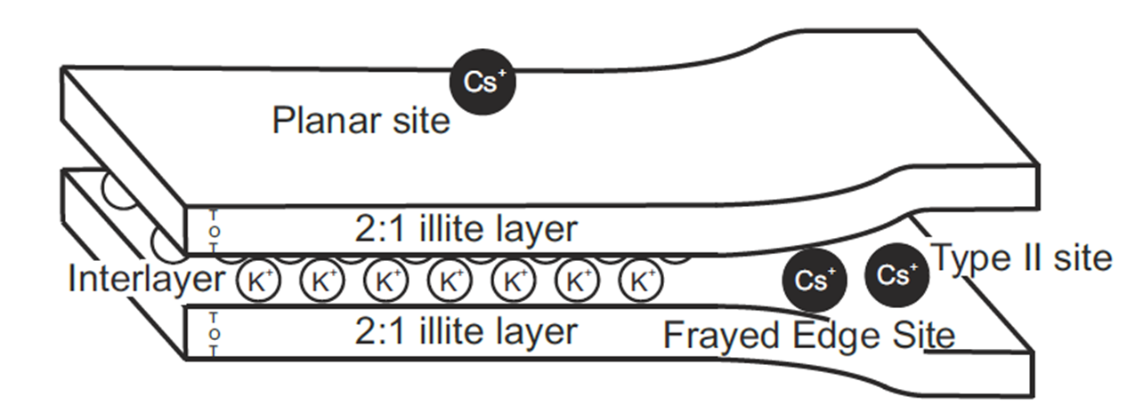
Three site model of Cs uptake
‘FES’ = Highly selective for Cs; low abundance (<1% of the total CEC)
Type II sites = less selective; greater abundance (~10% CEC)
Planar sites = not selective; very abundant

Slide 5
Cs sorption to Sellafield type sediment
Cs sorption to Fine grained glacial outwash sand.
1% clay - chlorite & illite/mica
(100 g L⁻¹ @48 hrs)
A – @ low Cs concentrations, Cs sorption to FES in competion with K
B – @ intermediate Cs concentrations, sorption to Type II sites in competion with Na & K
C – @ high Cs concentrations, sorption to planar sites / reaches capacity
Fuller et al., Appl. Geochem., 2014

Slide 6
pH dependence
Experiments at different Cs concentrations to probe each type of site independently
Discovered that Type II sites are amphoteric in nature (AlOH sites)
- used to extended the Bradbury and Baeyeans (2000) cation exchange model for our sediment system
Fuller et al., Appl. Geochem., 2014

Slide 7
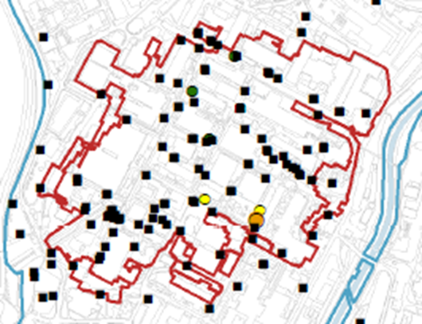
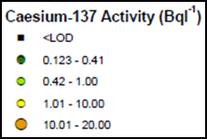

Application to Sellafield GW
HLLW
ILLW
Fuller et al., Appl. Geochem., 2014

Slide 8
Cs Sorption Kinetics
10 ppb Cs⁺
10mg L⁻¹ Ca-illite
100 mg L⁻¹ Ca-illite
Interaction characterised by rapid uptake period (<1 day) & slower continued uptake (>5 days)
Desorption becomes progressively more difficult with time
Comans and Hockley, GCA, 1992
de Koning and Comans, GCA, 2004

Slide 9
Microscopic investigation of Cs sorption on K-illite
Q. Can we visualise Cs sorption and incorporation over time?

Slide 10
Illite stability in the TEM
All images collected < 60 seconds
Fuller et al., Appl. Clay Sci., 2015

Slide 11
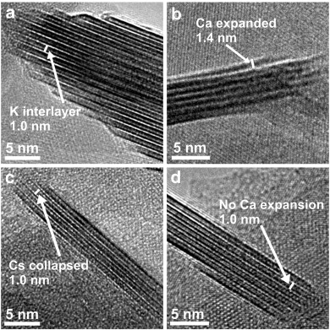
K exchange with Ca and Cs
K-illite (IMT-1)
20g L-1 in 1 M Cs⁺/ 0.1 M Ca²⁺
Bright field TEM images/EDX
Tecnai TF230 FEGTEM, 200KeV
Investigated the nature of the ‘Frayed Edge’
K → Ca → Cs → Ca
Fuller et al., Appl. Clay Sci., 2015

Slide 12
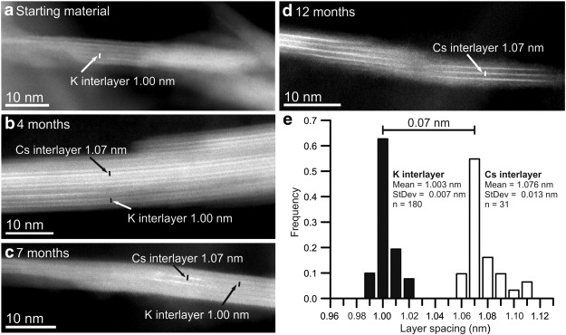
K → Cs with time
20g L-1 K-illite in 1 M Cs⁺, HAADF TEM images/EDX, FEI Titan G2, 200 KeV
Fuller et al., Appl. Clay Sci., 2015

Slide 13
DFT structural modelling
Used the composition of the starting material -
IMT-1 (Mg_{0.09} Ca_{0.06} K_{1.37}) [Al_{2.69} Fe(III)_{0.76} Fe(II)_{0.06} Mn_{tr} Mg_{0.43} Ti_{0.06}] [Si_{6.77} Al_{1.23}]O₂₀(OH)₄
to predict expansion expected K → Cs
Approximation | K-Filled | Cs-Filled | Difference
Local Density A. | 0.97 nm | 1.04 nm | 0.064 nm
Generalised Gradient A. | 1.03 nm | 1.09 nm | 0.071 nm
TEM measurements | 1.00 nm | 1.07 | 0.07 nm
DFT model was also used to help predict local co-ordination environment for EXAFS analysis
Fuller et al., Appl. Clay Sci., 2015

Slide 14
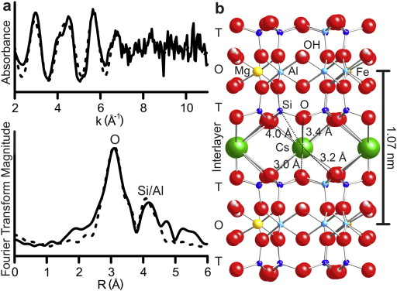
EXAFS analysis
Cs-illite (12 months)
b18 Diamond Light Source
Cs K-edge 35.98 keV
80 K, 12 hrs collection
Athena/Artemis-Feff6.0
Fit =
12 O atoms @ 3.0-3.4 Å
12 Si(Al) atoms @ 4.0 Å
Good agreement between TEM – DFT – EXAFS
Fuller et al., Appl. Clay Sci., 2015

Slide 15
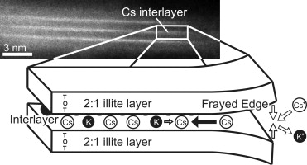
Conclusions & Implications
Cs initially sorbs to illite at FES site (crystal edge) – can causes interlayer collapse
In time Cs migrates into the interlayer by exchange with K – long term uptake
Cs is held in inner-sphere complex – difficult to exchange out / desorb

Slide 17
Recent papers from Japan
Mukai et al. 2016, ACS. Use autoradiograghy and TEM to show that Cs (in soil particles) is preferentially sorbed to vermiculated biotite and smectite clay interlayers
Saito et al. 2016, JER. Dialysis resin exchange of Cs from Fukishima soils estimate that the long-term desorption half life is ~2+ years

Slide 18
HRTEM Cs in Mg Vermiculite
Mg-vermiculite / K-mica
HAADF image &
Multislice contrast simulation (processed images)
Mg → Cs
Similar interlayer collapse as for illite
Also reported for vermiculated biotite
(HAADF images)
Exchange timescales ~25 hours (much quicker than illite)
Kogure et al., Chem. Let., 2012; Kikuchi et al., J Min. Pet. Sci, 2015

